Slide 1

Harvest Hills South Neighborhood Association
Crime Watch Meeting
Jaci Maguire
March 15, 2018

Slide 2
Agenda
Introductions
79th Street Crime Watch Success Story
Neighborhood Crime Patrol
Harvest Hills Neighborhood Association
Open Discussion
Door Prize

Slide 3
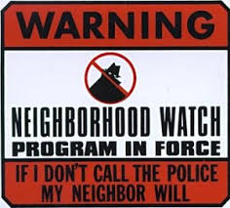
79th Street Success
Held 1st Crime Watch Meeting in October 2017
Invited 17 households – 11 participated
Get to know our neighbors
Leaving outside lights on at night
Solicitors
  Must have permit
Security Technology
- Ring Door Bell
Signing up for USPS Informed Delivery to email you a copy of your mail
Group Text and Group Email
Take baby steps but Dream Big

Slide 4
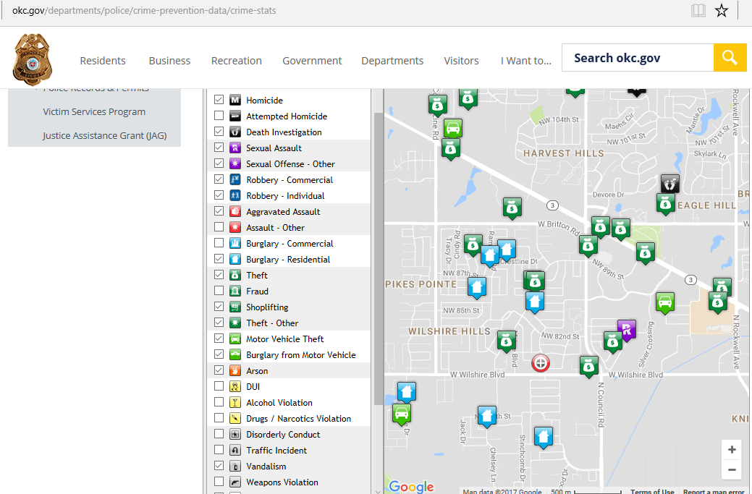
Crime in Area https://okc.gov/departments/police/crime-prevention-data/crime-stats
2017 – Harvest Hills South
Reported 46 crimes

Slide 5

Dream Big Plan
Roll our ideas out to all of Harvest Hills South to bring neighborhood together
Canvas the neighborhood to get buy in
  Nine neighbors went door to door to personally invite you to come here tonight or to deliver the flyer
Our Success –
All of you came tonight to share in our passion in keeping people safe
We have had neighbors from others streets come and ask if they can come join our small block meeting, so it is not just 79th St anymore
  Up to 15 households from 3 different streets

Slide 6

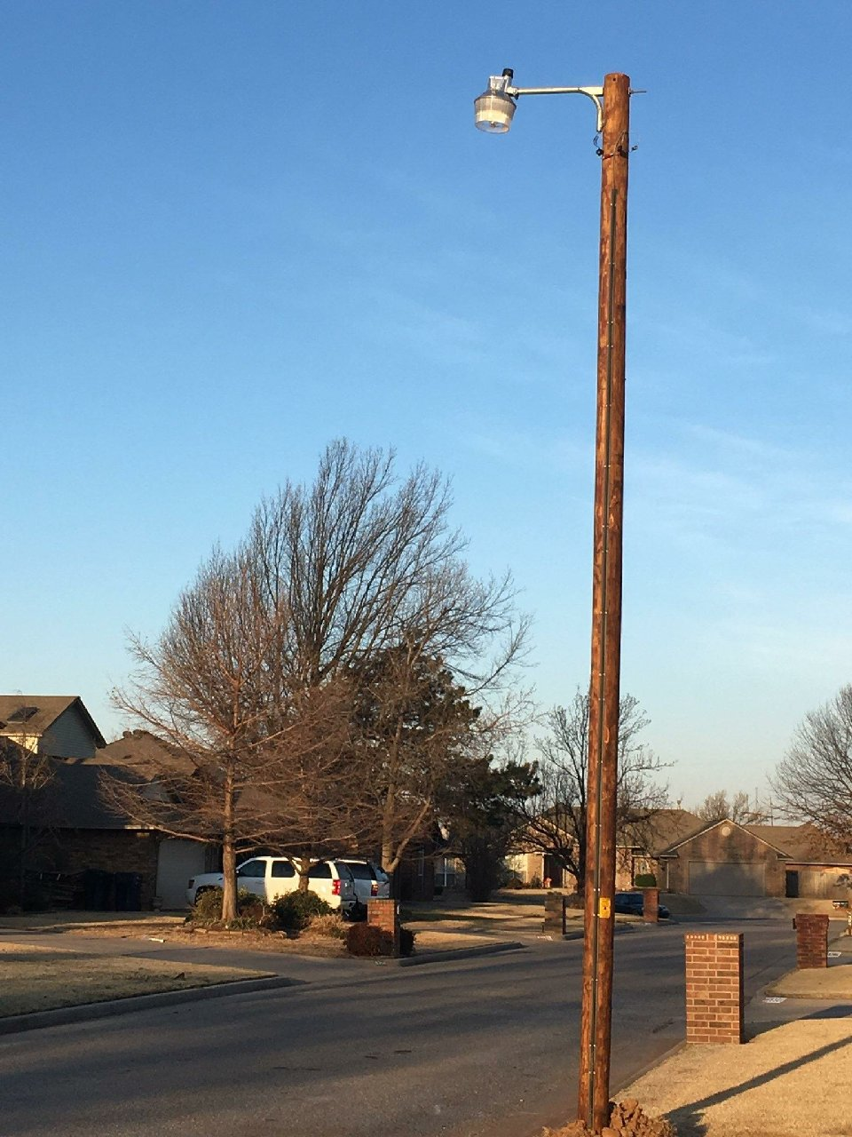
Street Lights
We came together to make it happen
ACtion
Evaluate needs on other streets
Ready to light up the whole neighborhood

Slide 7
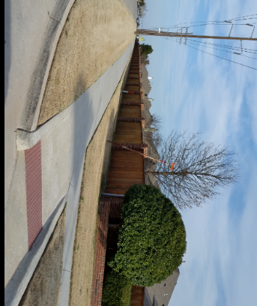
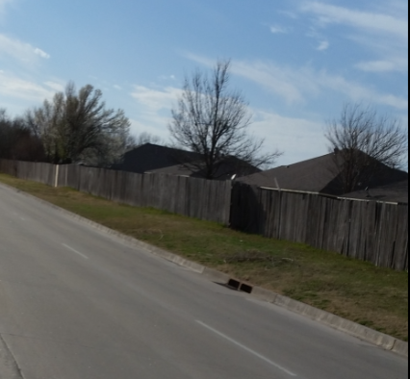
Rebuild fence on wilshire
How could we pay for it
  Ask neighbors to help contribute to a fund
    Example $50.00 x 300 = $15,000.00
    Fundraising activities
      Garage Sale with all sales to go to fence
Find out what grants are available
Obtaining quotes to see if it is feasible

Slide 8

Street Sign Toppers
Have our neighborhood standout
Cost: $50 Application Fee
$10.00 a street sign and they replace ALL signs in our neighborhood estimated 27 signs

Slide 9

Neighborhood Crime Patrol
Volunteers Needed
Must take a class offered by Police Dept
Two people per vehicle
Set up schedule
Need amber light and door signs to identify us
Cost – your time

Slide 10
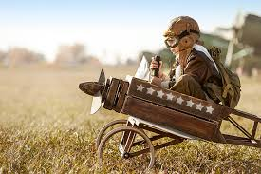
Dream Big
Make things happen
We can accomplish more as a large group
Each of us have unique talents and experience

Slide 11


911 Verses Nextdoor app
Nextdoor App
  Lost pets
  Only after 911 has been called
911 immediately
  Crime in progress
  Vandalism
  Suspicious behavior
  Threats
  Emergencies
  Nuisances

Slide 12
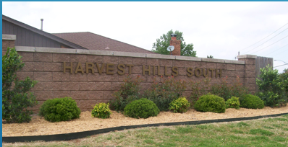
Harvest Hills south
Neighborhood Association
We are a volunteer Neighborhood Association
Annual dues $30.00 – join today!
Dues go to pay for the maintenance of the three entrances
Advertising for the annual Neighborhood Garage Sale Weekend
Neighbors Nite Out
Santa driving through at Christmas time to hand out candy
Website – harvesthillssouth.org

Slide 13
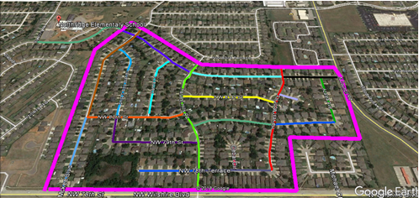
Harvest Hills South Neighborhood needs volunteers to champion their street

Slide 14

May election of officers
1st Vice President
  Works with board and steps in if President is unable
Secretary
  Keeps all meeting minutes
Newsletter/Website
  Update the web-site blog and any news letters or flyers

Slide 15
Comments
Open Discussion
Topics for future meetings
Door prize

Slide 16
Thank you for coming
Next Meeting will be in May 2018, watch for posting on website

